Slide 1

Year 9 Electricity:
Modelling Circuits

Slide 2
Learning Objective
To use an analogy to explain how electrical circuits work.
Success Criteria
To use simple models to describe scientific ideas.
To use a model to explain how electricity flows around a circuit.
To compare and contrast different models.

Slide 3


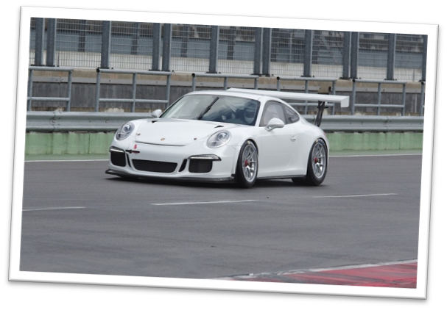


Starter: What’s the Link?

Slide 4

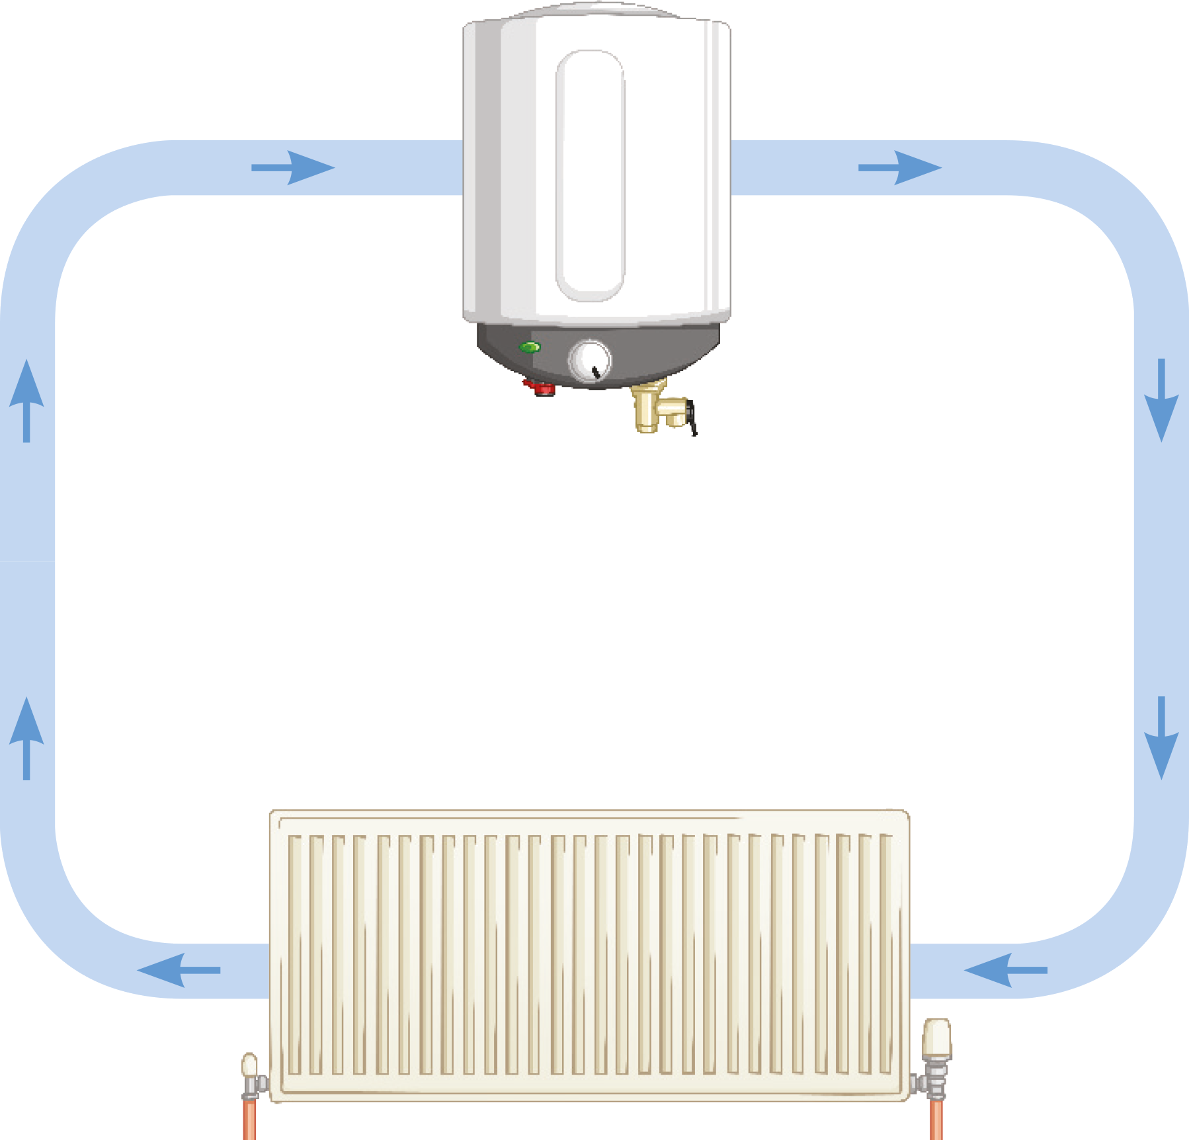

What Is a Model?
Scientists often use models to help them to explain difficult concepts.
For example, how could a central heating system be used to represent a model of an electrical circuit?
In this model, what represents the current, battery, wires and bulb?
They help scientists to think about an idea and explain it to others. However, some models are better than others.
boiler and pump
radiator

Slide 5
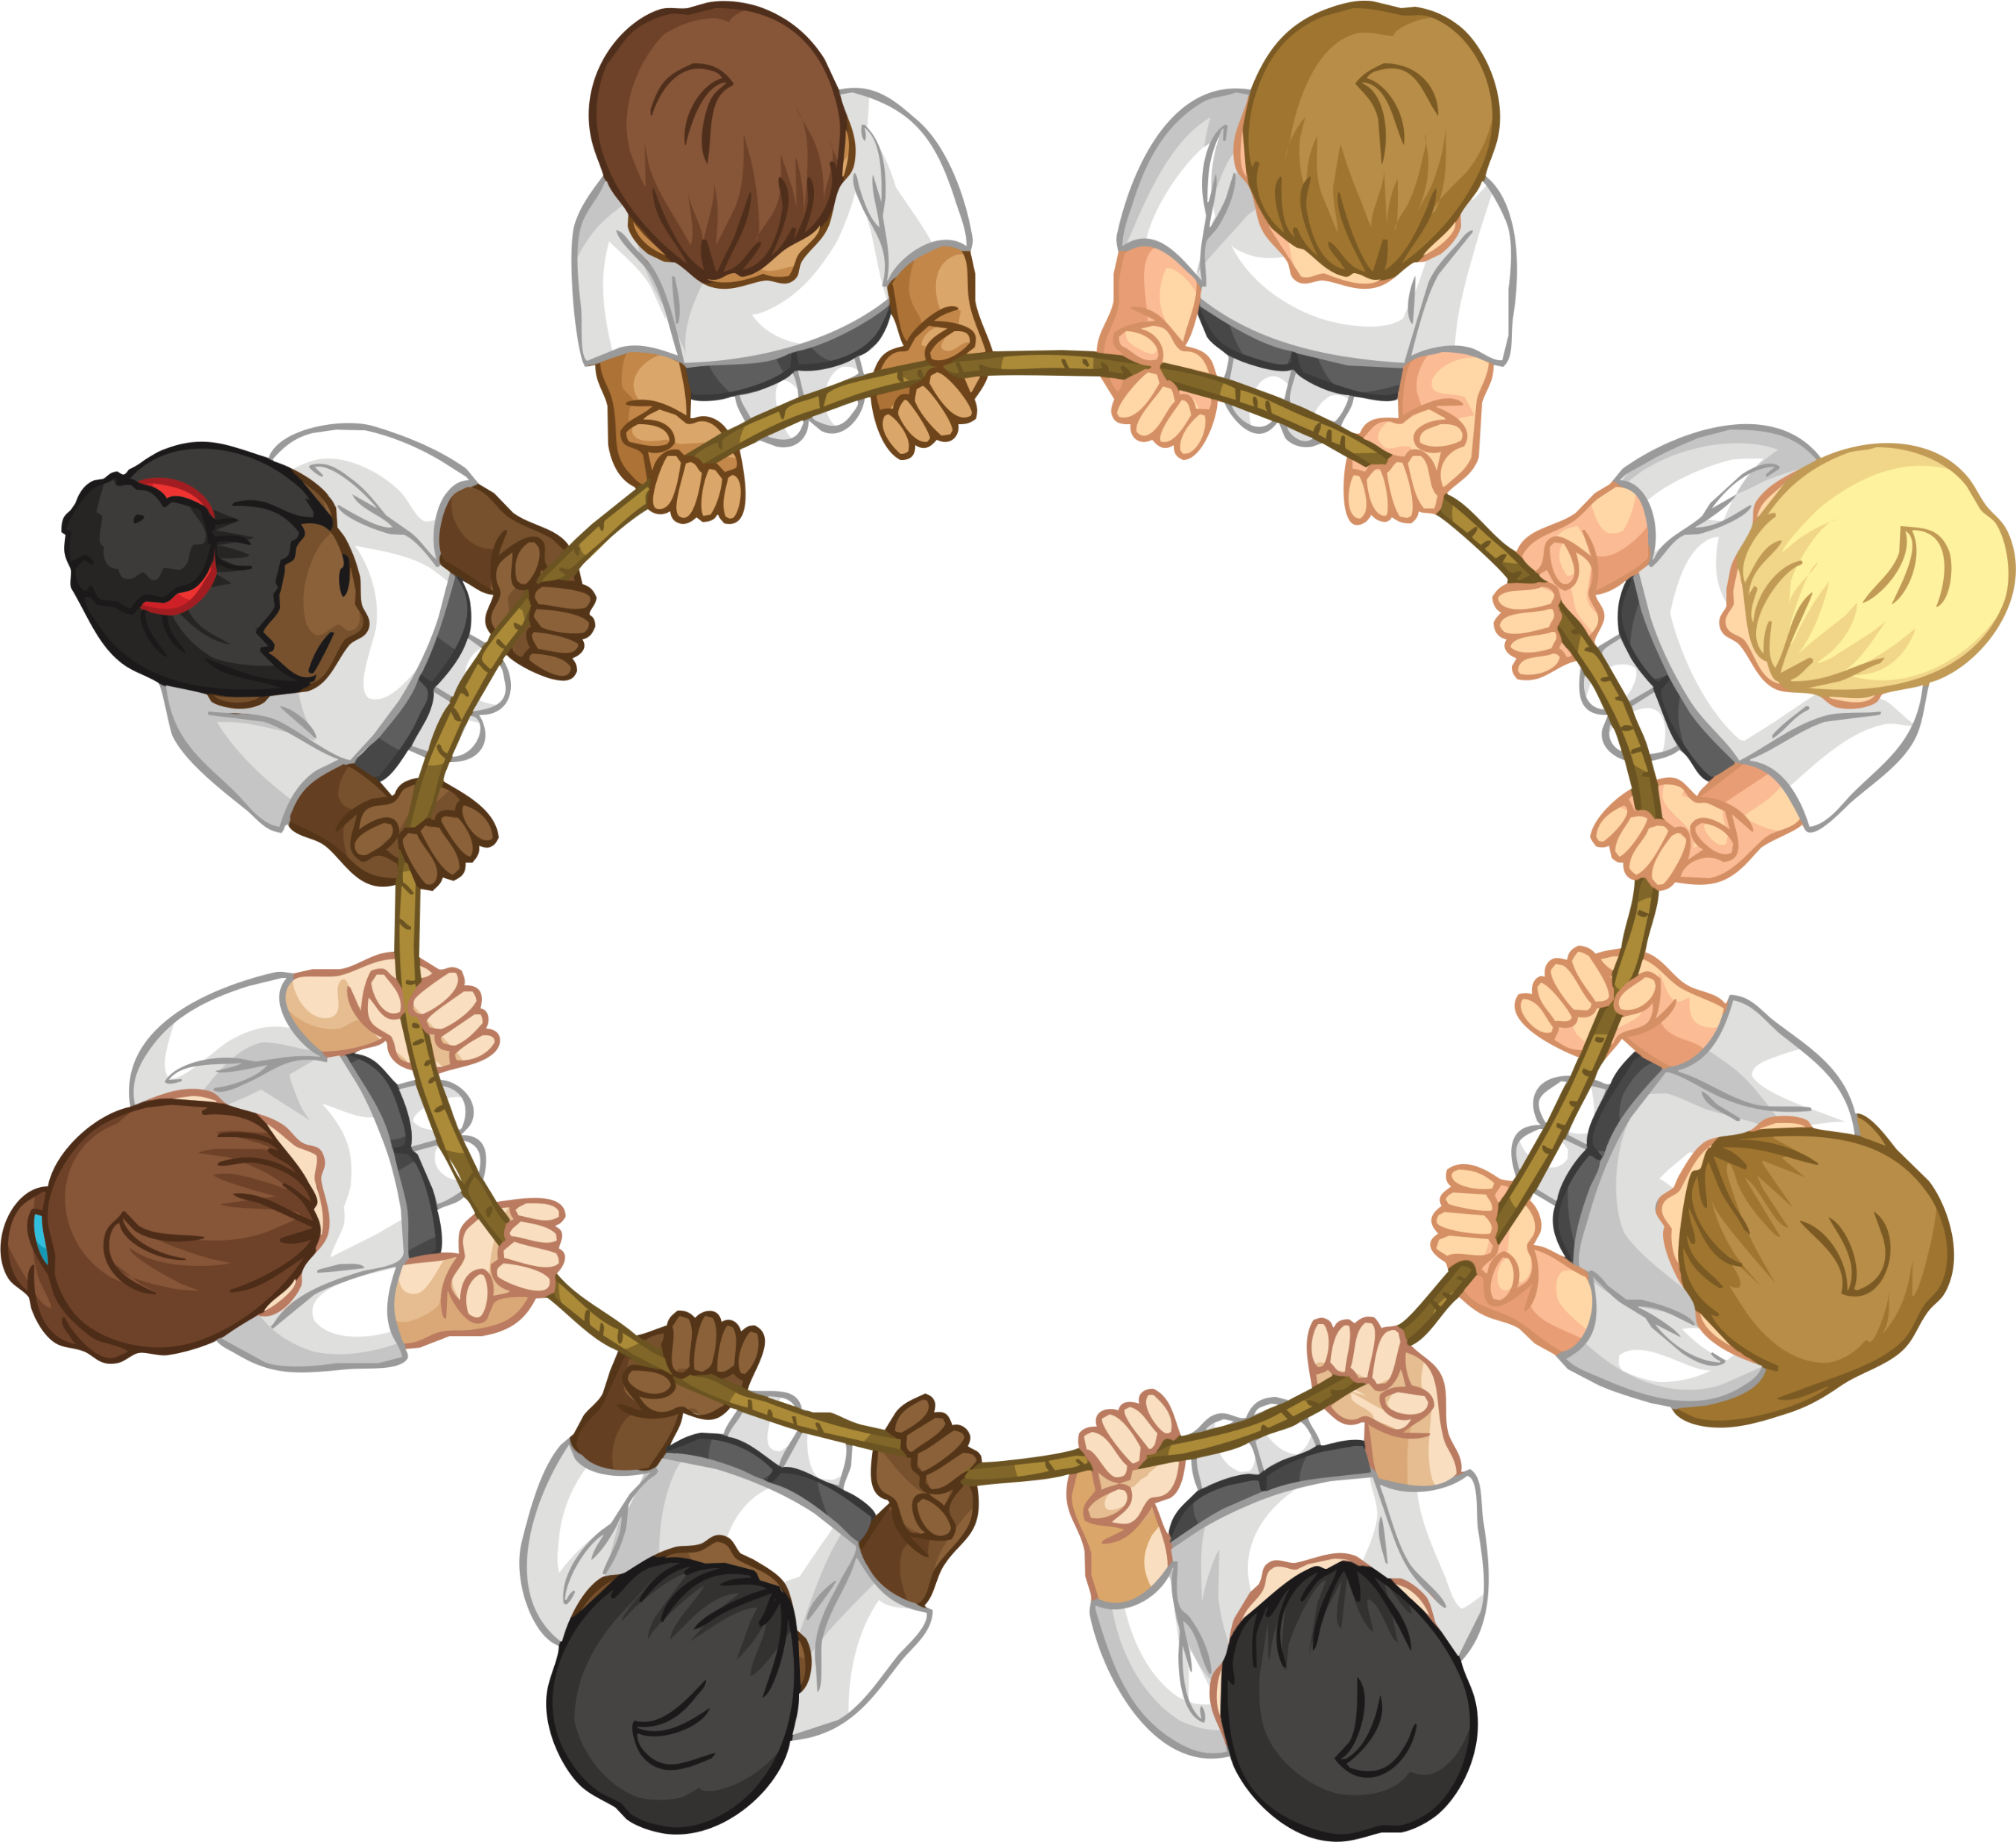
The Rope Model
Step 1
Stand up and push stools under.
Step 2
Ask students to form a large circle around the edge of the room.
Step 3
Students should have their palms facing upwards.
Step 4
Place a rope in the students hands.
Step 5
Students should loosely hold the rope.
Step 6
Elect one student to be the ‘battery’.
Step 7
The ‘battery’ should pull the rope
through the hands of the other
students.

Slide 6
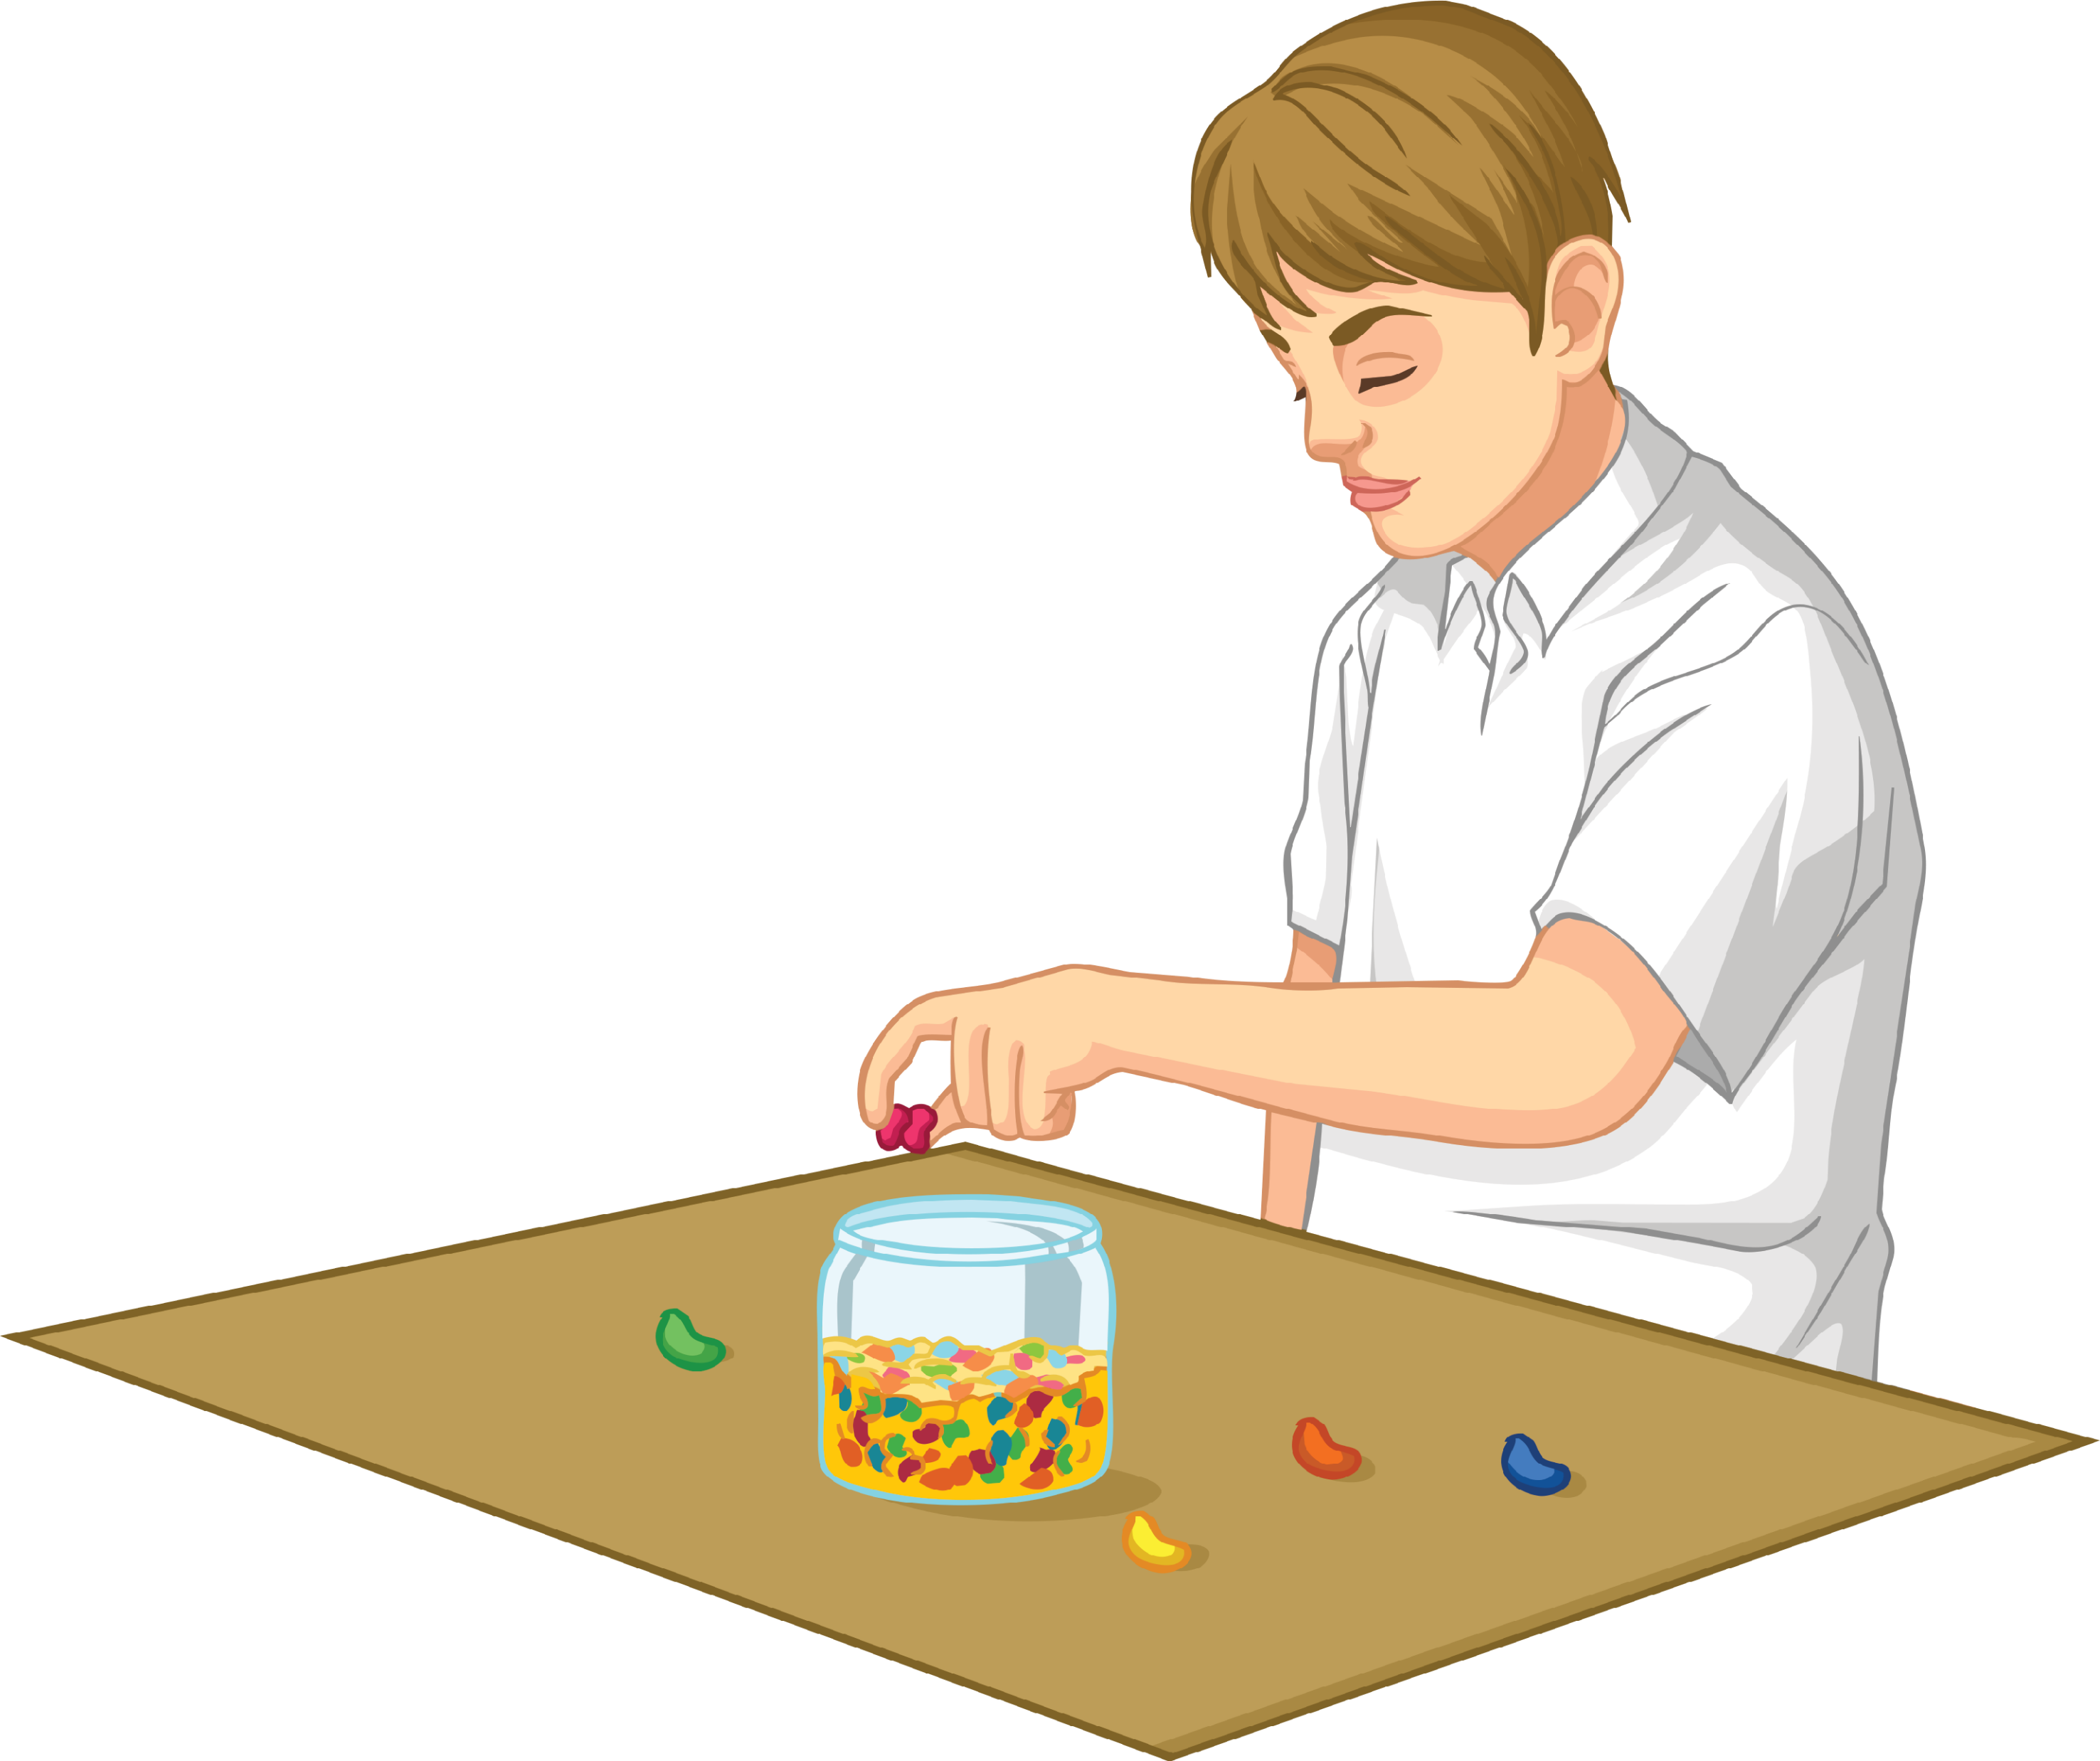
The Jelly Bean Model
Step 1
Stand up and push stools under.
Step 2
Ask students to form a large circle around the edge of the room.
Step 3
Place a table at the top of the circle. The table represents the ‘battery’.
Step 4
On the table, place a jar of jelly beans or
other small sweet.
Step 5
On the opposite side of the circle to the table,
place a strip of tape on the floor.
Step 6
Students will walk around the room.
Each time they go past the table, the
students should collect two jelly beans.

Slide 7
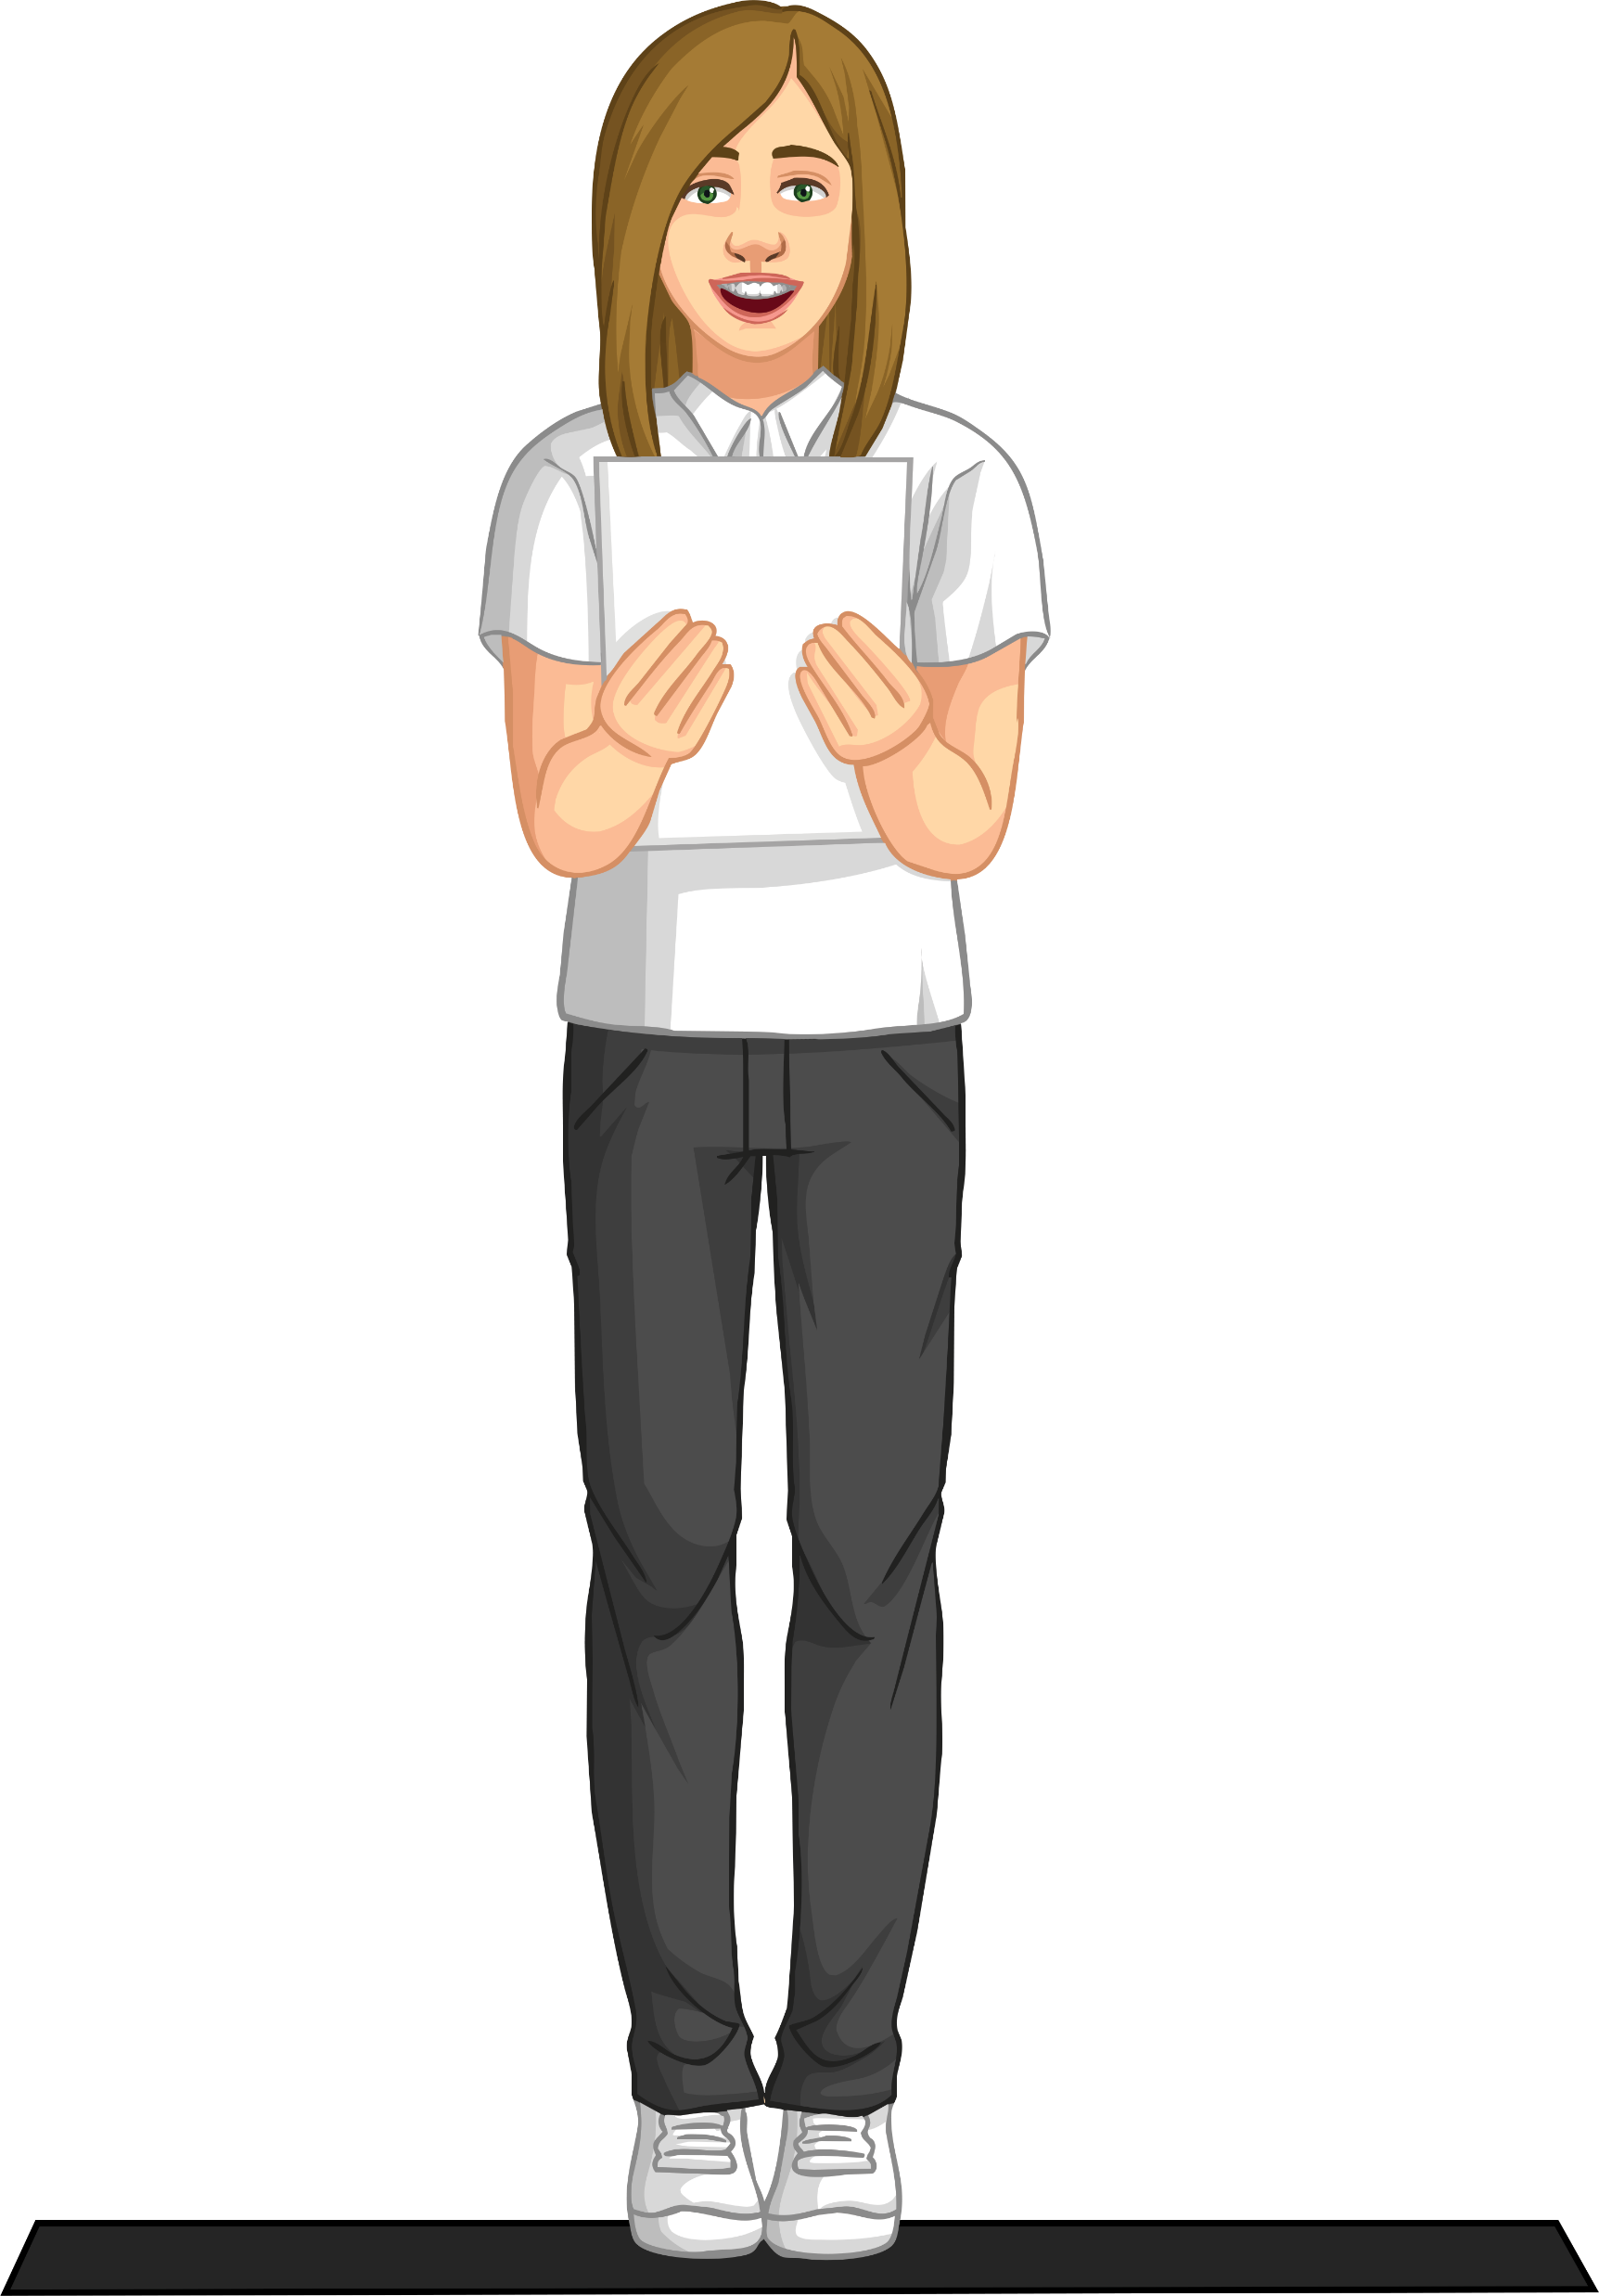
The Jelly Bean Model
Step 7
As students reach the tape on the opposite side, they should repeat the following tongue twister.
Peter Piper picked a peck of pickled peppers.
A peck of pickled peppers Peter Piper picked.
If Peter Piper picked a peck of pickled peppers,
Where’s the peck of pickled peppers Peter Piper picked?
Step 8
After the students have said the tongue
twister, they should eat the jelly beans
and return to the table.

Slide 8
Model Strengths and Weaknesses
What are the strengths (good points) of this model?
What are the weaknesses (bad points) of this model?
boiler and pump
radiator

Slide 9
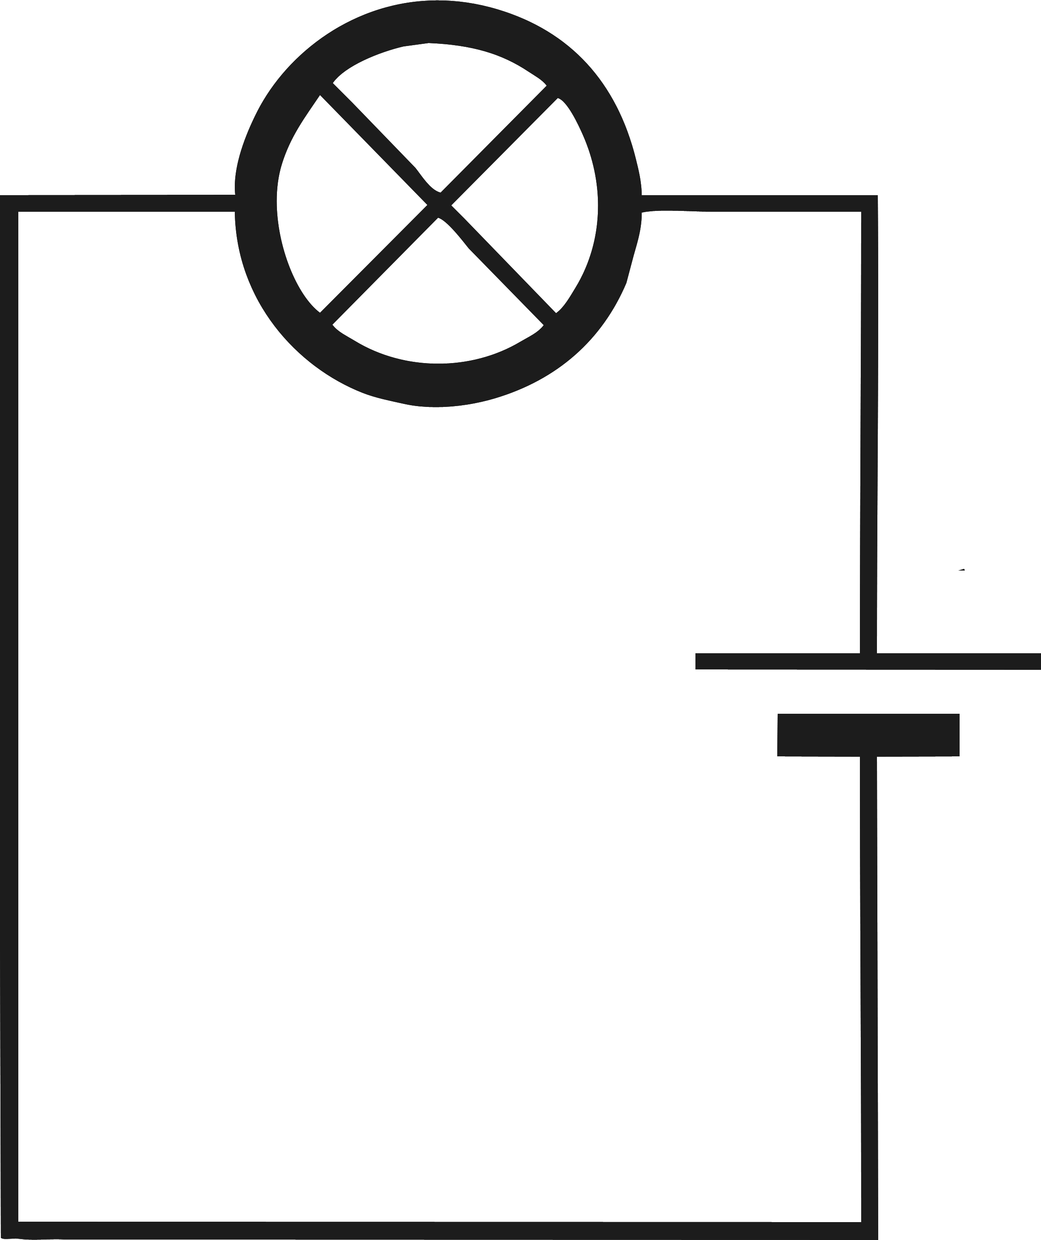
Model Strengths and Weaknesses
There is a pump that pushes water round the system. The pump does a similar job to the battery in that it pushes the charges around the circuit. The bigger the push, the bigger voltage.
There are pipes that carry the flow of water. Instead of water, the wires carry the flow of charges around the circuit. This is the electric current.
The bulb and the radiator are both very similar in that they use energy supplied by the circuit.
boiler and pump
radiator

Slide 10
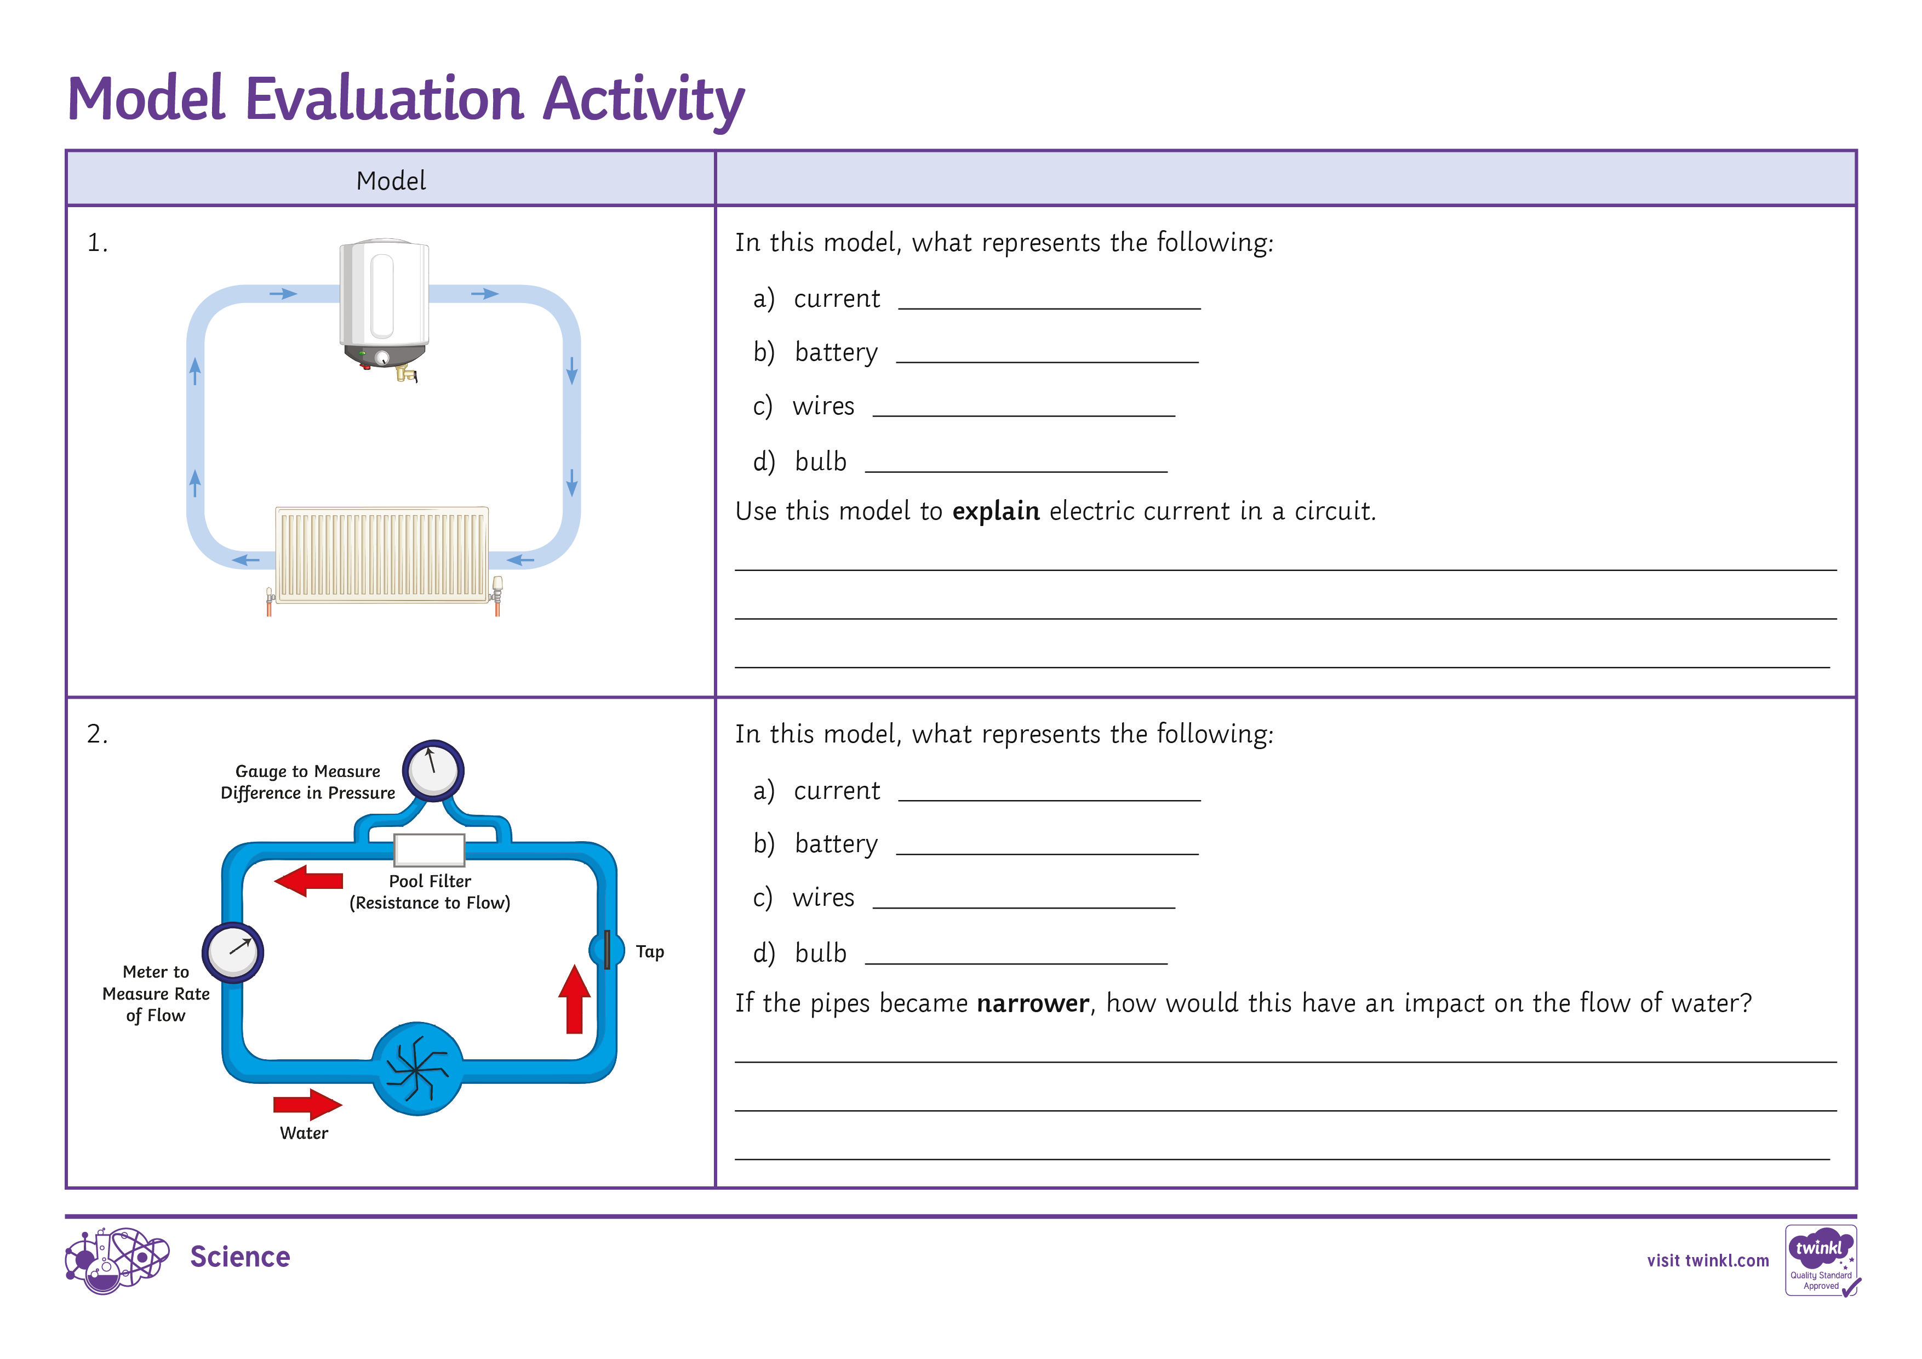
Plenary
Using the Model Evaluation Activity Sheet, asses your knowledge of the models and create your own.

